Slide 1
Configuration of Spring and JPA for development

Slide 2
Configuration

Slide 3
JPA Abstraction Layer
Any Relational Database Dialect
Database
PostgreSQL

Slide 4
persistence.xml
<?xml version="1.0" encoding="UTF-8"?>
<persistence version="2.1" xmlns="http://xmlns.jcp.org/xml/ns/persistence"
xmlns:xsi="http://www.w3.org/2001/XMLSchema-instance" xsi:schemaLocation="http://xmlns.jcp.org/xml/ns/persistence
http://xmlns.jcp.org/xml/ns/persistence/persistence_2_1.xsd">
//…
<?xml version="1.0" encoding="UTF-8"?>
<persistence version="2.1" xmlns="https://jakarta.ee/xml/ns/persistence" xmlns:xsi="http://www.w3.org/2001/XMLSchema-instance" version="3.0" xsi:schemalocation="https://jakarta.ee/xml/ns/persistece https://jakarta.ee/xml/ns/persistence/persistence_3_0.xsd">
//…

Slide 5
<dependency>
<groupId>org.springframework.boot</groupId>
<artifactId>spring-boot-starter-data-jpa</artifactId>
</dependency>
Adding Jars with Maven
Version
Transitive Dependencies

Slide 6
EntityManagerFactory
EntityManagerFactory entityManagerFactory = Persistence.createEntityManagerFactory("PUNIT"); EntityManager entityManager = entityManagerFactory.createEntityManager(); entityManager.getTransaction().begin();
Registration reg = new Registration("Bob", "Builder", "bobthebuilder@mycompany.com"); entityManager.persist(reg); entityManager.getTransaction().commit(); entityManager.close();
entityManagerFactory.close();

Slide 7
<dependency>
<groupId>org.postgresql</groupId>
<artifactId>postgresql</artifactId>
<scope>runtime</scope>
</dependency>
Adding PostgreSQL Maven Dependency
Version
Transitive Dependencies

Slide 8
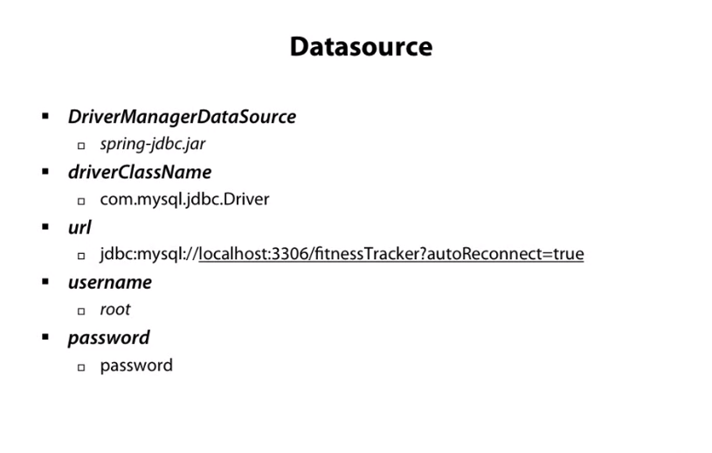

Slide 9
Transactional
@Transactional
public void createRegistration(Registration reg) { registrationRepository.save(reg);
}

Slide 10
logging.level.org.hibernate.SQL=debug
spring.jpa.show-sql=true
spring.jpa.properties.hibernate.format_sql=true
Tips and Tricks
Log Level
Show Queries

Slide 11

Summary
Database
Legacy Added Jars Transactions
Tips and Tricks

